Slide 1
IMPLEMENTATION OF VPLS ON SOFTWARE DEFINED NETWORK USING ONOS
CONTROLLER BASED ON RASPBERRY-PI 3
Group 1
1. Mohamad Khairul Zamidi bin Zakaria (202180)
2. Muhammad Muzammel bin Imamuzel (202179)

Slide 2
INTRODUCTION
-Traditional computer networks still have severe flaws today. Because it employs a low-level setup and a configuration that takes a long time, especially for large-scale networks, such a device is still difficult to configure. All network devices will be focused on a single controller that can operate, administer, and monitor the network more efficiently due to Software Defined Network (SDN) technology.
-In this project,we will be using Open Network Operating System (ONOS) based on SDN technology which is able to separate the control plane and the data plane on the network device.The ONOS will be installed on Raspberry-Pi 3 device to minimize the usage of PC on the network.ONOS also support VIrtual Private Lan Service(VPLS) which able to create network on another Layer 2 network using OpenFlow protocol.

Slide 3
Objectives
To implement SDN network by using ONOS Controller on Raspberry PI 3
To implement Virtual Private LAN Services in SDN network
To measure the Quality of Service (QoS) TIPHON in the SDN network
Notes:
Telecommunications and Internet Protocol Harmonization over Network

Slide 4
Problems
How to use ONOS controller as control plane?
How to use Raspberry Pi as controller with the Raspbian Operating System?
How to measure the Quality of Service (QoS)?

Slide 5
Literature Review
Software Defined Network
All network devices will be centered on one controller that can control, manage and monitor the network more effectively[2].
OpenFlow
Communication protocol that connects the controller with the data plane. OpenFlow give access to manipulate forwarding plane directly from network device[3].
Open Network Operating System (ONOS)
Open source SDN controller for building next-generation SDN/NFV solutions. Built to provide high availability, scale-out and network performance[4].
Virtual Private LAN Service (VPLS)
Provide Ethernet-based multipoint to multipoint communication over IP network[6].

Slide 6
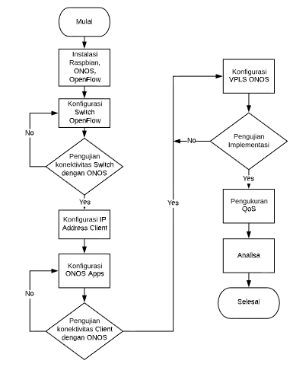
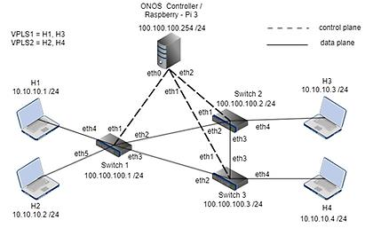
System Design and Implementation
Figure 2: Network topology
Figure 1: Method flowchart

Slide 7
Hardware | Software
3 x Switch OpenFlow 10 x UTP cable 2 x Converter USB-to-Ethernet 1 x Raspberry Pi 3 4 x PC | Wireshark iPerf (Network performance measurement and tuning)
Table 1: Hardware and software requirements

Slide 8
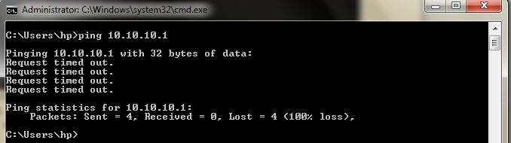
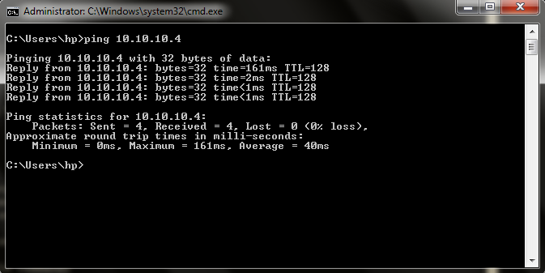
Test Results (VPLS testing)
Figure 3 : Ping from H2 to H1
Figure 4 : Ping from H2 to H4

Slide 9
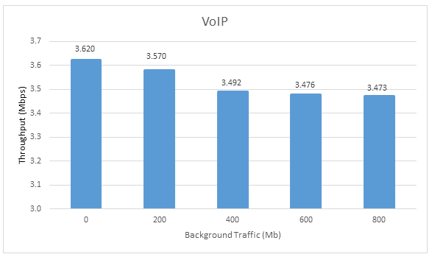
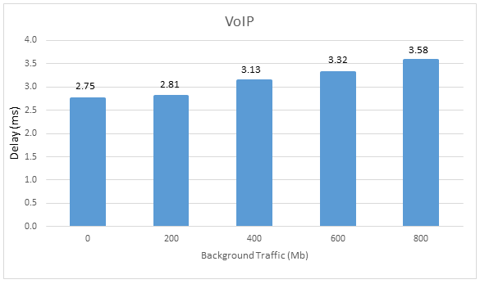
VoIP performance Test
Input are 200Mb, 400Mb, 600Mb, and 800Mb background traffic with UDP protocol.
Figure 5 :Throughput VoIP
Figure 6 : Delay VoIP
TIPHON standard throughput
-3.623Mbps (No background traffic)
-3.473Mbps (With background traffic)
TIPHON standard delay
-2.75ms(No background traffic)
-3.59ms(With background traffic)
Notes:
Telecommunications and Internet Protocol Harmonization over Network

Slide 10
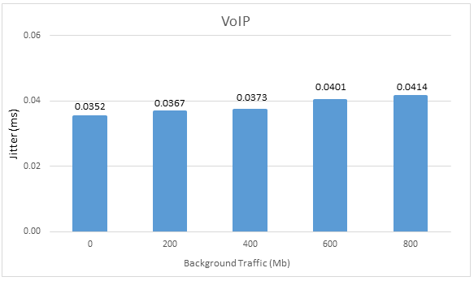
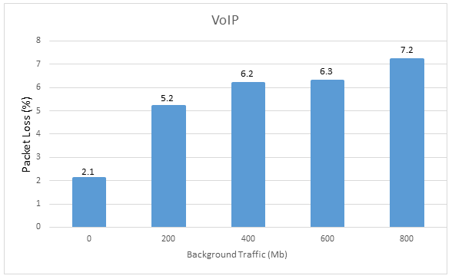
VoIP performance Test
Figure 7 : Jitter VoIP
Figure 8 : Packet Loss VoIP
TIPHON standard jitter
-0.0352ms (No background traffic)
-0.0414ms (With background traffic)
TIPHON standard packet loss
-2.1% (No background traffic)
-7.2% (With background traffic)
Notes:
All the performance like throughput and delay in the TIPHON standard

Slide 11
Conclusion
Implementation of VPLS in SDN network that separates control plane and data plane can be make by using Raspberry Pi 3 with ONOS controller.
Implementation of VPLS in SDN network using ONOS controller can divide the private network between hosts.
The test results of the performance of implementation of VPLS in SDN network by using Raspberry Pi 3 shows the QoS (throughput, delay, jitter, packet loss) is in the good standard TIPHON.
We can improve this SDN network by using other controller.
We can increase the number of devices to see how the performance will be.

Slide 12
References
F. Ramadhan, R. Primananda, and W. Yahya, “Implementasi Routing Berbasis Algoritme Dijkstra Pada Software Defined Networking Menggunakan Kontroler Open Network Operating System,” J. Pengemb. Teknol. Inf. dan Ilmu Komputer; Vol 2 No 7, vol. 2, no. 7, pp. 2531–2541, 2017.
Ummah, “Perancangan Simulasi Jaringan Virtual Berbasis Software-Define Networking,” Indones. J. Comput., vol. 1, no. 1, pp. 95–106, 2016.
T. I. Bayu and E. E. Tahan, “Software Defined Network (Sdn) Simulation Concept Using Raspberry Pi,” J. Terap. Teknol. Inf., vol. 2, no. 2, pp. 1–11, 2018.
M. W. Putra, E. S. Pramukantoro, and W. Yahya, “Analisis Perbandingan Performansi Kontroller Floodlight, Maestro , RYU , POX Dan ONOS Dalam Arsitektur Software Defined Network ( SDN ),” J. Pengemb. Teknol. Inf. dan Ilmu Komput., vol. 2, no. 10, pp. 3779–3787, 2018.
D. S. R. Sari, R. Munadi, “Analisis Performansi Segment Routing Pada Software Defined Network Menggunakan Kontroler ONOS,” vol. 6, no. 2, pp. 3469–3476, 2019.
P. Monika, R. M. Negara, D. D. Sanjoyo, F. T. Elektro, U. Telkom, and L. I. Monitor, “Analisis Performansi Jaringan Software Defined Network Menggunakan Metode Intent Monitor And Reroute ( IMR ) Pada Controller ONOS,” 2019.

